Slide 1
Teams + SharePoint = Better Together
Bob German
PTA
Michael Panciroli
PTA

Slide 2
Teamwork in Microsoft 365
M
Yammer
Teams
Yammer
Yammer
Outlook
Inner Loop
Outer Loop
People you work with regularly on core projects
People you connect with openly across the organization
File collaboration
Team projects
Meetings & calling
Sales opportunities
Leadership connection
Communities of practice
Internal communications
Intelligent intranet
Content collaboration
SharePoint
Intelligent video
Stream
Email
Pervasive availability. Targeted communications.
Notes:
Lots of ways people work
Inner/outer introduced 2 ignites ago
What to use when
There are several ways to communicate in O365
Email
Millenials / Firstlines
Targeted, soloed conversations
Broader team excluded
When it comes to Modern Networked conversations, openness is critical
(Inner) – core collaboration scenarios
In meetings, voice, video, calling
Shared deliverables
Responding to Rfp’s
Core team collaboration
Teams is the hero experience
(Outer) – not all work gets done that way 92%
Top down communications – satya
Knowledge sharing
Communities of practice
Conversation are hero
Yammer, Teams (tools, conversations, communications all in one place
SharePoint - No matter how you are communicating in O356 your likely to be collaborating on files in Sharepoint
Single source for documents in Office 365.
Stream – you tube for the enterprise

Slide 3

Content collaboration in Microsoft 365
M
Document collaboration with Office apps
Shared content in Teams and Outlook
Anywhere access to
files with OneDrive
Engage employees with Yammer & Stream
Digital experiences with SharePoint spaces & intranet
SharePoint
Security
AI
Extensibility
Notes:
How tools fit together
The fact that you ca. Co- edit documents with people is only possible because they are stored on SharePoint.
Outlook modern attachments
Has it's own hero experiences

Slide 4
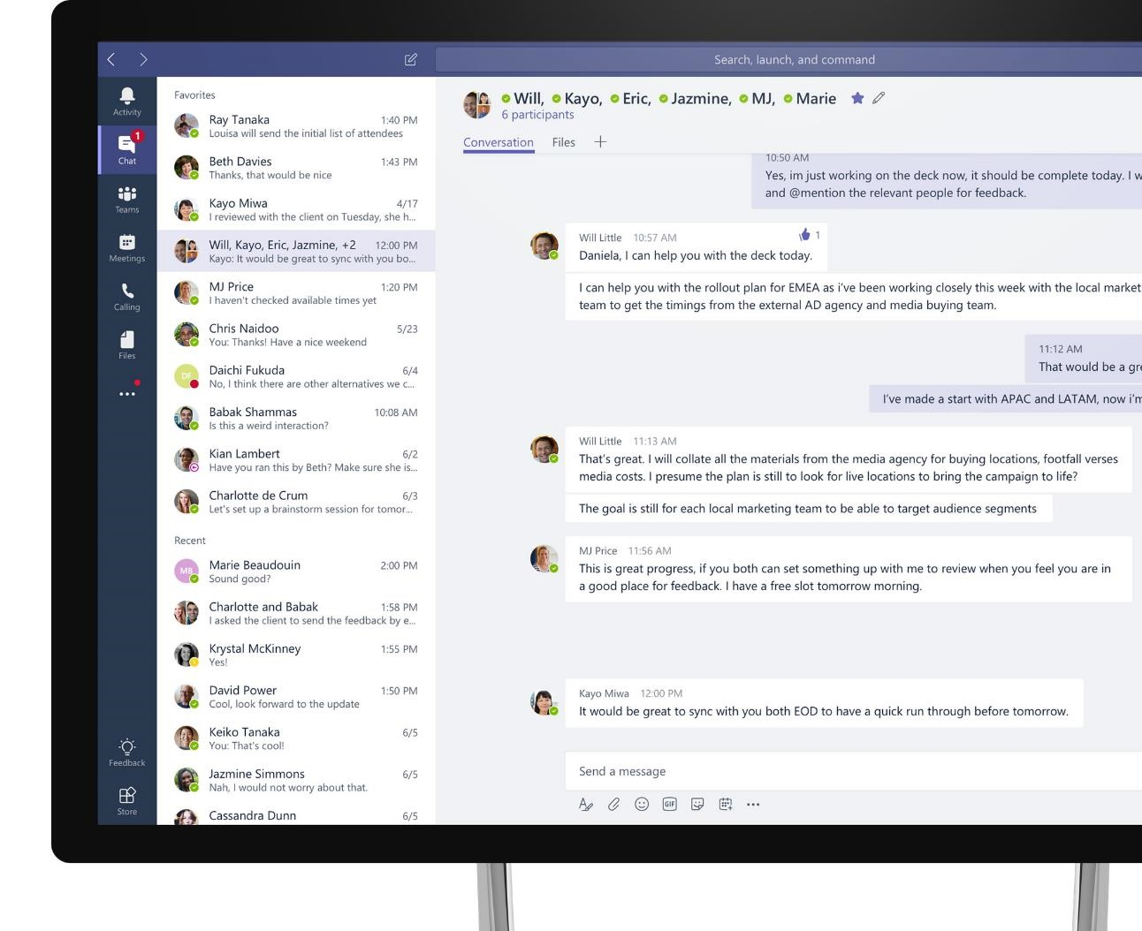
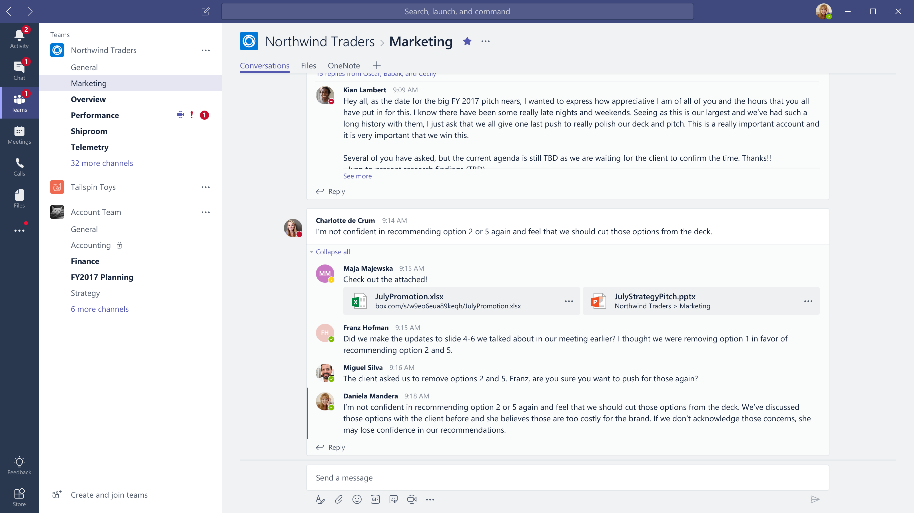








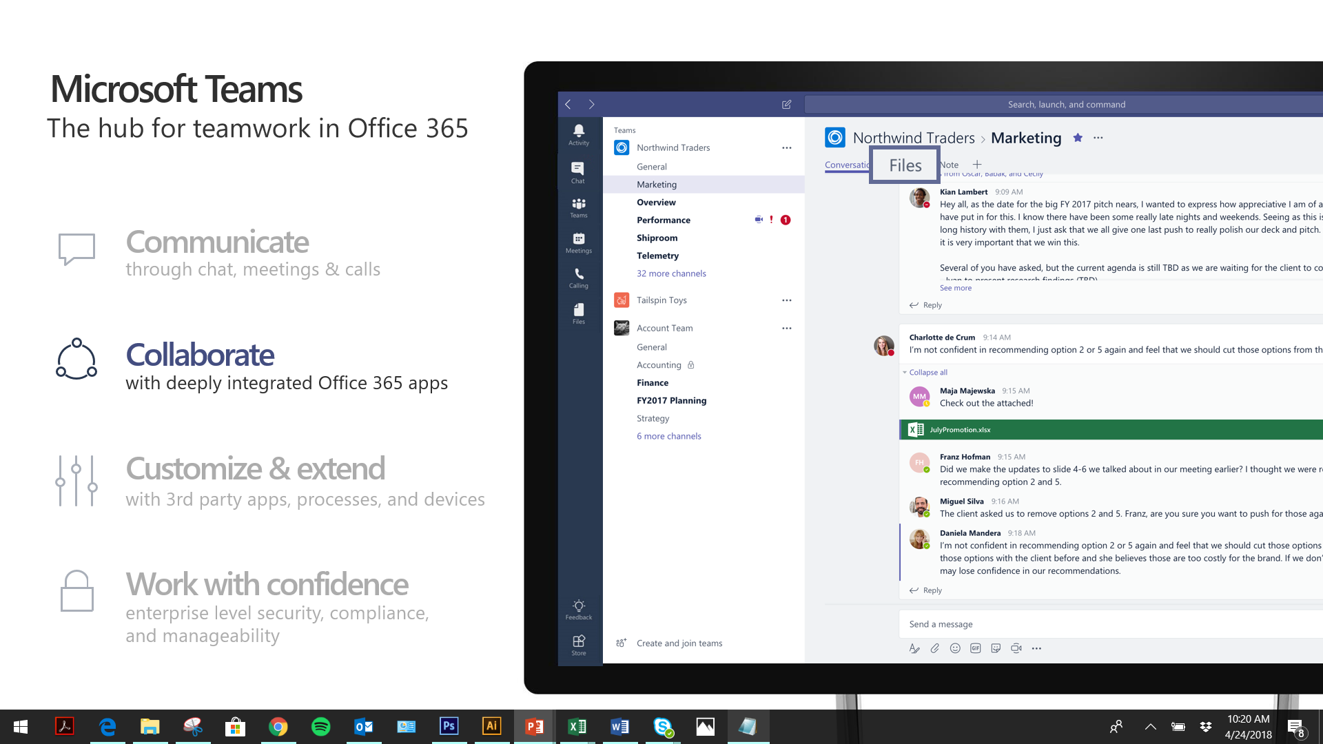



Microsoft Teams
M
The hub for teamwork in Office 365
Communicate
through chat, meetings & calls
Collaborate
with deeply integrated Office 365 apps
Customize & extend
with 3rd party apps, processes, and devices
Work with confidence
enterprise level security, compliance, and manageability

Slide 5

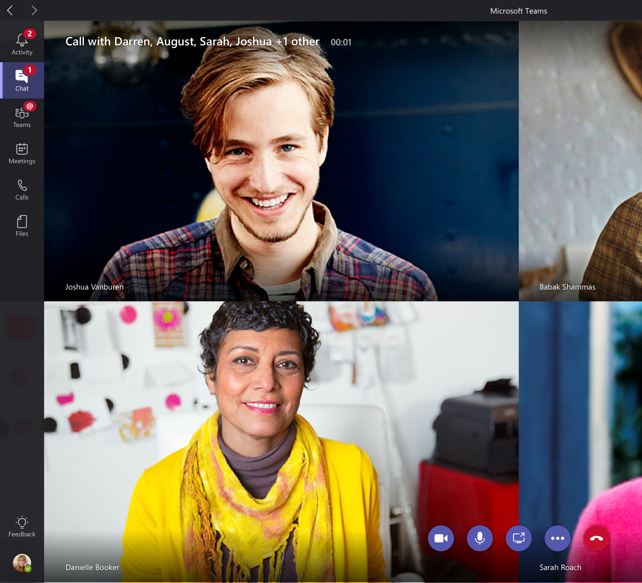
Chat, calls & meetings for today’s teams
Communicate in the moment and keep everyone in the know
Chat, calls, meetings within your team and across organizational boundaries
Private chats for 1:1 or small group conversations
Schedule and join online Skype meetings with HD video, VoIP, and dial-in audio conferencing options
Have a dedicated phone number with advanced features
Available across mobile, desktop and browser; integrated with meeting room devices
Notes:
Microsoft Teams is the hub for teamwork in Office 365 and provides a shared workspace in which teams inside and outside of an organization can communicate in the moment and keep everyone in the know.
We’ve recently added additional communications capabilities within Microsoft Teams, including voice and video experiences powered by Skype.
Now you can chat, call and have meetings with everyone on your team, whether they’re inside your organization or an outside partner.
Team members can engage in private 1:1: chats or in group conversations that are visible to the entire team. This modern conversations experience supports persistent, threaded chats to keep everyone engaged. Team conversations are open by default, and of course there is the ability for private discussions, too. People can include emojis, memes and other fun graphics in their messages, which allows team culture to shine through.
Now let’s talk about meetings….Microsoft Teams offers a complete meeting solution supporting sharing, video and audio conferencing. This will enable an organization to transform an ordinary meeting into modern meeting in the following ways:
Before a meeting- team members can share and review information and conversation history on the subject matter, without having to leave Microsoft Teams.
During a meeting: team members can share their desktop, meeting attachments or a PowerPoint deck. The meeting can take place in either audio conferencing or video and can be recorded
After a meeting: team members can review recorded meetings and view previous meeting details in conversation history, giving them complete context
Users have a dedicated phone number and advanced calling features and support such as blind and consultative transfer, delegation and support for emergency calls.
Finally, Teams is available across mobile, desktop and browser and integrated with communications and meeting room devices

Slide 6
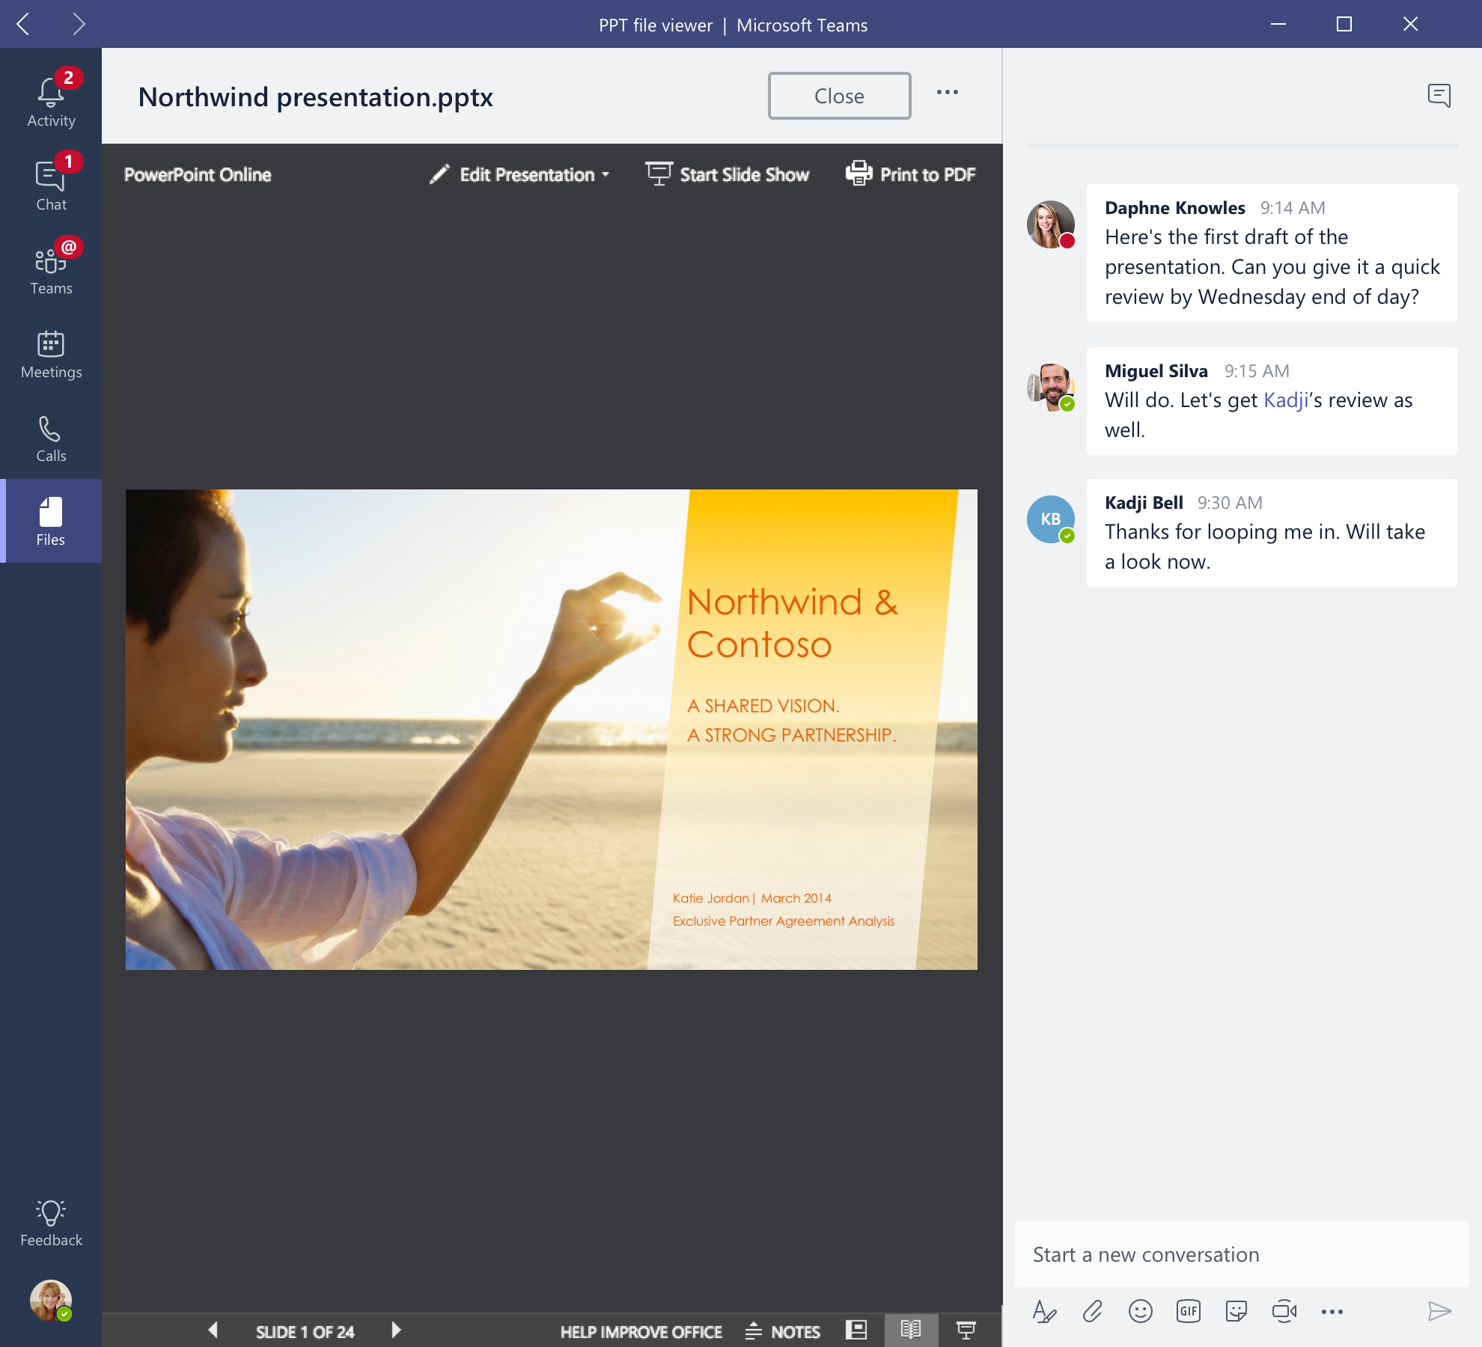
Integrated Office 365 apps
Give your team quick access to information they need right in Office 365
Conversations, files and tools live in a team workspace
Co-author and edit with Office and other files right in the app
Integrated with Skype, SharePoint, OneNote, Power BI and Planner
Search across people, files and chats with intelligence from Microsoft Graph
Email integration to keep the whole team in the loop
Notes:
Microsoft Teams also means more time for productivity as a team members do not have to toggle between different apps. Instead, they can access and act on information right within the Microsoft Teams experience.
The Office apps and services that people use every day - Word, Excel, PowerPoint, OneNote, SharePoint, even Power BI - are all built-in, so people have the information and tools they need right within the context of Microsoft Teams.
Users can co-author and edit with Office and other files right in the app
Microsoft Teams is also integrated with Skype, SharePoint, OneNote, PowerBI and planner, so teams can work in a central place with all the necessary tools in order to pursue team objectives.
Microsoft Teams leverages the intelligence capabilities of the Microsoft Graph. A team member can access information on organization reports and do searches for contacts within an organization.
We’ve built integration with email so users can forward an email message into a Team’s channel for further discussion and sharing.

Slide 7
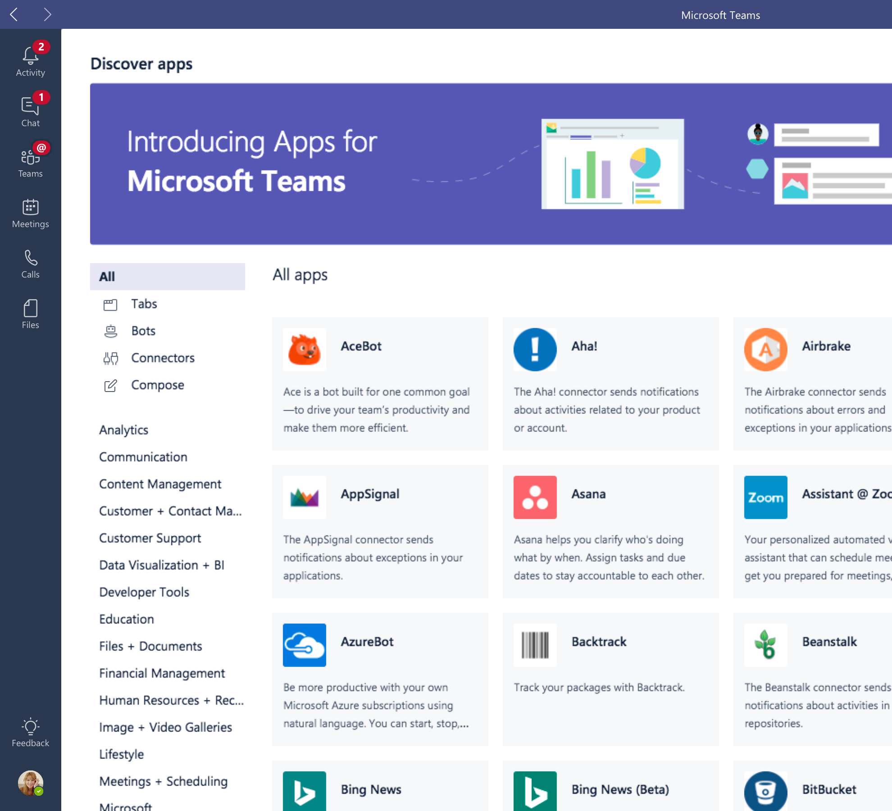
Customizable and extensible
Tailor your workspace to include apps and services for the team and organization
Pin important files for easy reference in the workspace
Add bots that work on a team’s behalf
Integrate cloud services, explore data and get updates from the apps your team uses every day
Use the Teams developer platform to build integrations to existing business process
Manage trusted apps for employees and the organization
Notes:
Every group is unique, so we have made it easy for teams to tailor their workspace to include apps and services which are relevant to their team or organization.
For example, you can pin important files for quick reference so the whole team can access them in just one click.
You can set up your channels so that conversations on certain topics happen in designated spaces.
You can add intelligent bots to interact with Microsoft Teams. Bots can answer natural-language questions and perform lightweight tasks such as FAQs.
You can bring in cloud services to explore data and get updated from the apps a team uses daily. Where 3rd party services are included, notifications can be customized so the team never misses a beat.
To bring our users a breadth of customization options, we’re working with more than 150 partners.
We have also created an extensible platform, to enable building apps with a rich set of capabilities to enable higher-performing teams. The Microsoft Teams developer platform enables integrations to existing business process. IT can also manage trusted apps for the employees and the organization.

Slide 8

Enterprise security, compliance & manageability
Get the enterprise-level security and compliance features you expect from Office 365
Served from our global hyper-scale cloud, including ability for local data residency
Compliance leadership with EUMC, HIPAA & more
Built-in information protection with eDiscovery and audit
Multi-factor authentication and secure guest access
PSTN connectivity in Office 365 with advanced call management
Notes:
Finally, Microsoft Teams benefits from the Office 365 hyper-scale, enterprise-grade cloud, delivering the advanced security and compliance capabilities customers expect.
Data encryption at all times, at-rest and in-transit.
Ability to have local data residency for core customer data at rest, plus failover and disaster recovery (see public Office 365 Roadmap for locations)
Human back-up via on-call support engineers standing by 24×7
Multi-factor authentication for enhanced identity protection.
It supports key standards including SOC 1, SOC 2, EU Model Clauses, HIPPA, and more. Since preview, we’ve added mobile management with Microsoft Intune and new features for compliance and litigation support, including audit log search, eDiscovery and legal hold for channels, chats and files.
PSTN connectivity in Office 365 with option for connecting existing on-premises investments in the future
Advanced call management including call routing, auto attendant, call queues, and reporting
Easily manage users, usage, and settings in the Office 365 Admin Portal
IT controls to manage trusted apps for employees/the organization
While security and compliance capabilities are critical for enterprise customers, our responsibility at Microsoft goes beyond this. Our mission talks about empowering every person to achieve more. With that in mind, we’re focused on building an inclusive experience for the entire group, including support for those who use screen readers, high contrast, and keyboard-only navigation, to enable the collective brainpower and potential of everyone.

Slide 9

Intelligent communications
Harnessing the power of intelligence to transform calls and meetings
Cognitive services
Machine learning
Microsoft Graph
Notes:
On the horizon, we see a sea change coming. As organizations need more collaboration and communication tools, the promise of AI and machine learning are becoming real, and we have massive amounts of intelligence coming through Microsoft Graph. What if we could harness the intelligence of cognitive services, machine learning, and Microsoft Graph to give our teams a better way to collaborate and communicate—and change the very nature of calling and meeting experiences? This vision of intelligent and informed communication and collaboration is now possible.
Intelligent and informed communication and collaboration is the way forward, opening doors and breaking down barriers to bring together the experience and expertise in every organization. With intelligent communications in place, users will be more productive and connected, always on the same page with the insights and tools they need to communicate and collaborate more effectively.

Slide 10
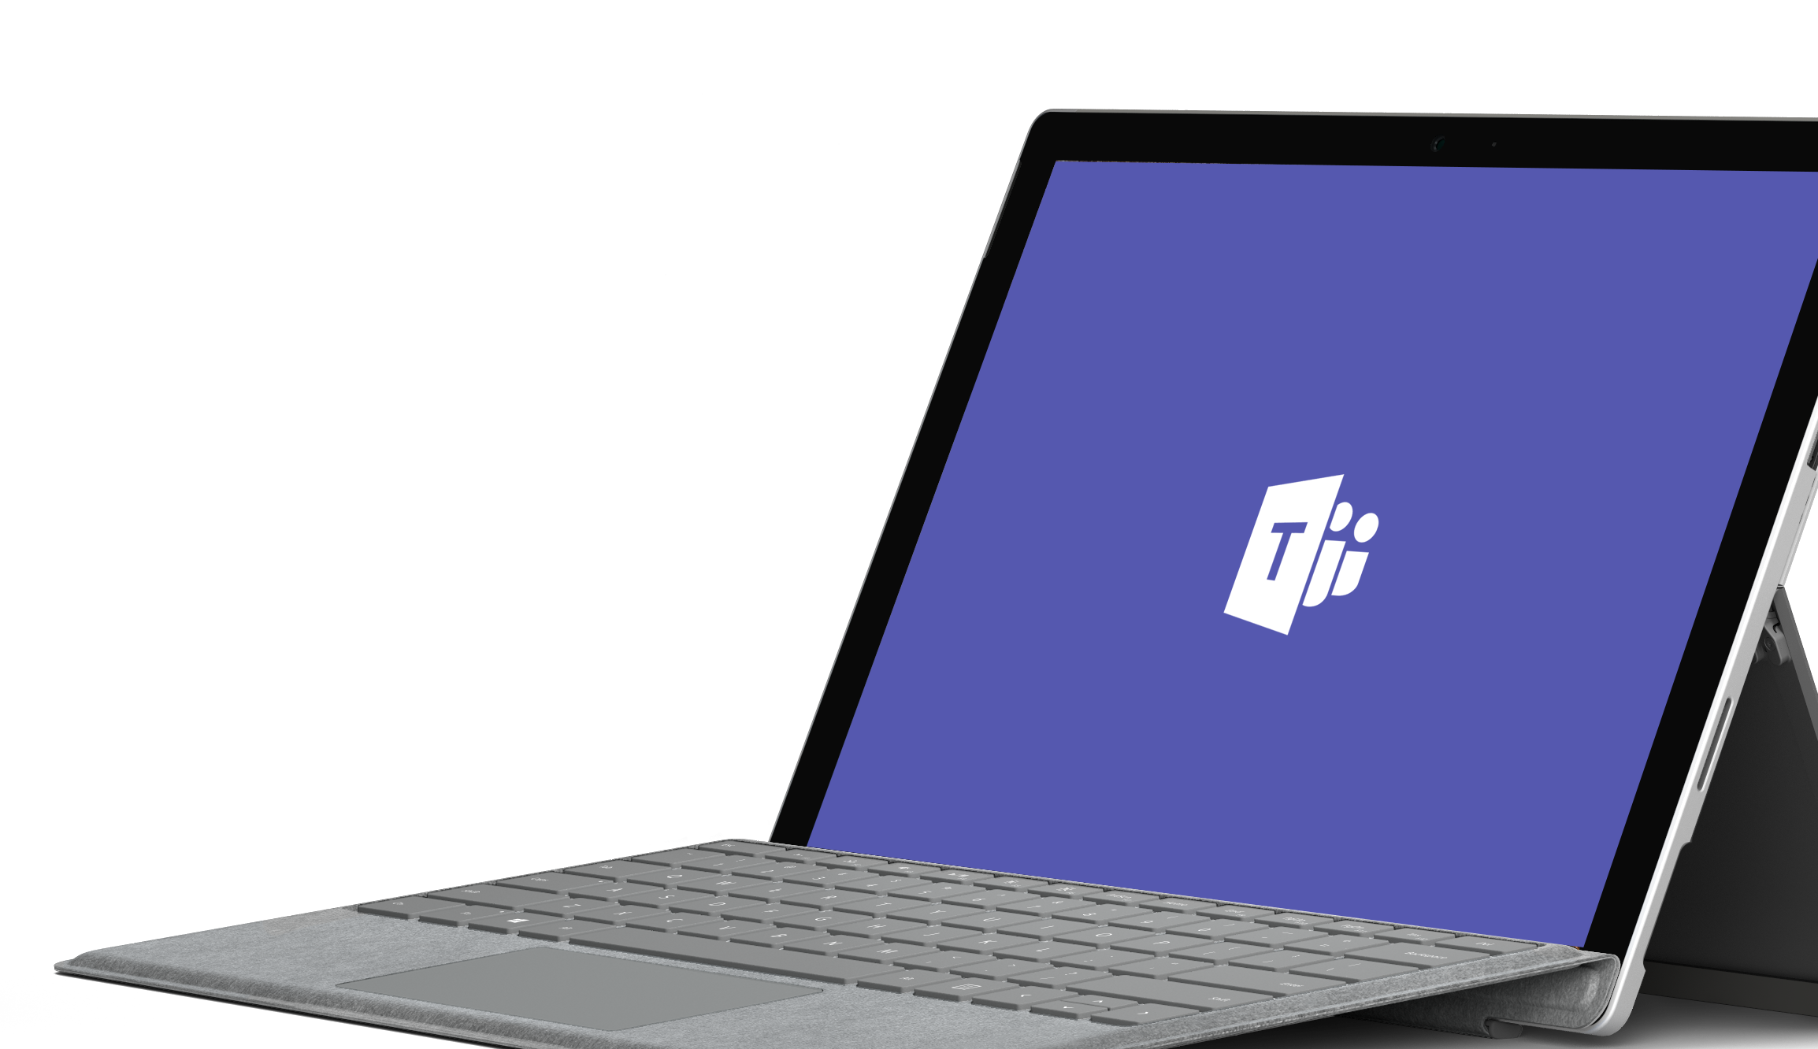
Demo

Slide 11

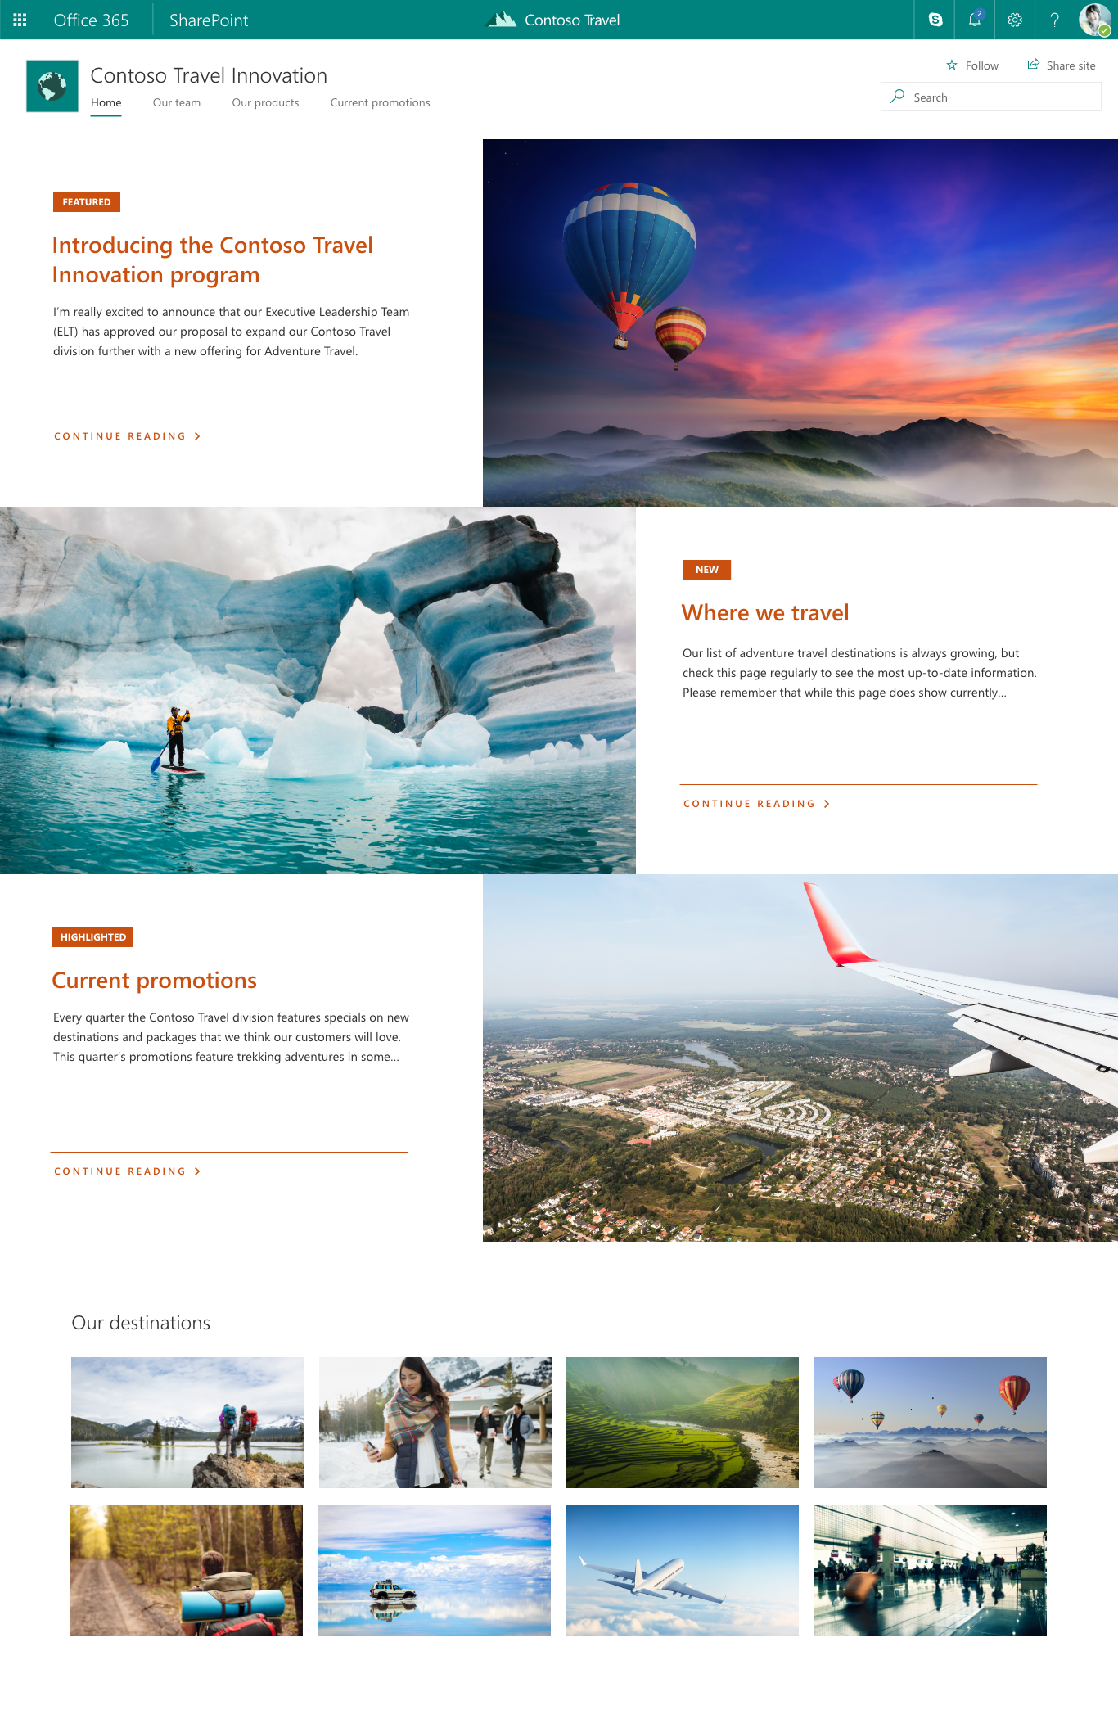
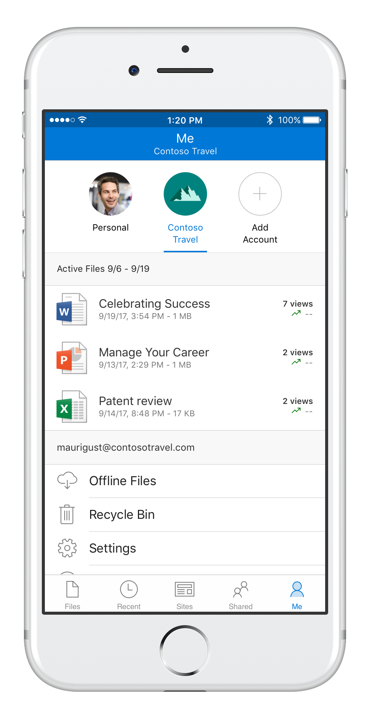
SharePoint Content collaboration for the modern workplace
M
Content services
shared files, pages, data and apps across Office 365
Anywhere access to files
simple and secure sharing with OneDrive
Intelligent intranet & search
connect people, news, knowledge and apps
Modern solutions framework
no-code apps, workflow, and custom development

Slide 12

M
Notes:
Sharepoint loves teams
20 years of value… you!
But now we have this great new hub for Teamwork
Opportunity for new experiences and audiences
Fully committed to bring SharePoint experience to teams
And committed to bring Teams experiences to SharePo

Slide 13
Collaboration Silos
B
Outlook
Lync/Skype4Biz Client
Browser Office Clients
Exchange
Lync/Skype4Biz
Teams and SharePoint
SharePoint
Persistent Messaging
Real-time
Shared Workspace
Organized by Date
Organized by Person
Organized by Topic

Slide 14
Demo
M
SharePoint Files Integration in Teams

Slide 15
Demo
B
SharePoint Pages and Web Parts in Teams
SharePoint Lists in Teams
SharePoint News in Teams

Slide 16
M
Microsoft Teams Resource Cheat Sheet
Office 365 Roadmap
Success with Teams Practical Guidance
Coffee in the Cloud on YouTube
Microsoft Technical Community
All public feature delivery dates
Filter by product
Product forums and blogs
Driving Adoption forum
O365 Champion’s Corner
Diversity & Inclusion Forum
Learn how to plan, deliver, adopt and manage Microsoft Teams
Includes Skype for Business to Teams transition guidance
Short how-to videos for IT Pro’s and Champions
Long form end user & administrator training
https://aka.ms/O365Roadmap
https://aka.ms/TeamsCommunity
https://aka.ms/SuccessWithTeams
https://aka.ms/CoffeeintheCloud

Slide 17
Thank You!

